Slide 1
Extreme Programming
Presented By:
Sameer Shrestha
Anil Shrestha

Slide 2
Extreme Programming
One of the best and widely used Agile methods
Name was proposed by Beck in 2000
Several new versions of a system may be developed by different programmers, integrated and tested in a day.

Slide 3
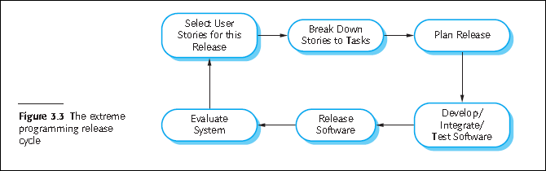
Extreme Programming release cycle

Slide 4
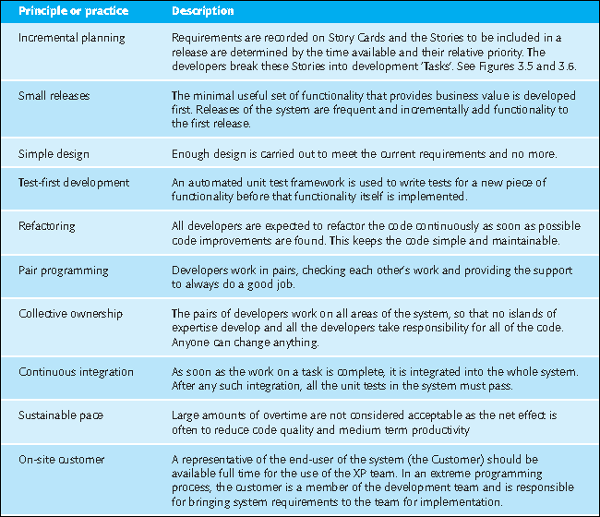
Extreme programming practice

Slide 5
Concept
being able to adapt to changing requirements at any point during the project life is more realistic and better approach than attempting to define all requirements at the beginning of a project and then expending effort to control changes to the requirements.

Slide 6
Goals
The main aim of XP is to lower the cost of change. (In traditional development methods (like SSADM) the requirements for the system are determined at the beginning of the development project and often fixed from that point on. This means the cost of changing the requirements at a later stage will be high.)
Organizes people to produce higher-quality software more productively.
XP attempts to reduce the cost of changes in requirements by having multiple short development cycles, rather than a long one.
Extreme programming also introduces a number of basic values, principles and practices on top of the agile programming framework.

Slide 7
Activities
XP describes four basic activities that are performed within the software development process:
Coding
Testing
Listening and
Designing.

Slide 8
Coding
The advocates of XP argue that the only truly important product of the system development process is code – software instructions that a computer can interpret. Without code, there is no working product.
Testing
Extreme programming's approach is that if a little testing can eliminate a few flaws, a lot of testing can eliminate many more flaws.
Unit tests
Acceptance tests

Slide 9
Listening
Programmers must listen to what the customers need the system to do what “business logic” is needed.
They must understand these needs well enough to give the customer feedback about the technical aspects of how the problem might be solved, or cannot be solved.
Designing
Good design will avoid lots of dependencies within a system; this means that changing one part of the system will not affect other parts of the system.

Slide 10
Thank You!

